Slide 1
Iteration 1 -
ICS 499
Abdul Hazari, Ans Khan, Muhammad Sohail

Slide 2
Transaction for Non-Profit Organization

Slide 3
Iteration 1
Introduction
Vision and Scope
Business Value
Feasibility Studies
Software Development Methodology
Proposed System Functionalities
Initial use case diagram of your system
Project log
Hardware and Software Requirements
Project plan

Slide 4
Introduction
The system concerns with an application that does transaction management for any non-profit organisation, that gets funding from individuals.
Any non-profit organisation can be chosen and money can transferred to that specific organisation or NGO.
Transaction can only be processed by adding or selecting credit cards

Slide 5
Vision
To provide an easy to use application that can help in transaction management of individuals for various organisation. With this application in hand there is no use for individuals to go on to different websites of organisations and make donations.
This application will be served as a common platform for individuals to make donations to various organisations.
It’s a very handy and time saver kind of application.

Slide 6
Scope
The donors or users will add their credit cards, organisation name which they want to donate to and the amount to be donated so that they can make the transaction to the organisation.

Slide 7
Business Value
It will be beneficial for the donor and the organizations that it will save them time and will be cost efficient

Slide 8
Feasibility Studies
The application will be web-based for the users. We are planning to have a public survey which will help us include more functionality to this application and make is better and easy to use.

Slide 9
Software Development Methodologies
We will be using Java in the eclipse environment for back-end part of it, to develop this software and its functionalities.
A GUI will be created in which all the functionalities will be implemented, HTML is going to be used for the front end part it.

Slide 10
Proposed System Functionalities
The system will contain these functionalities:
Sign up and Sign in.
Pick an organization of their choice.
Amount of money they want to donate.
Choose the Payment Method.
Make the payment.
Get the confirmation after making the payment.

Slide 11
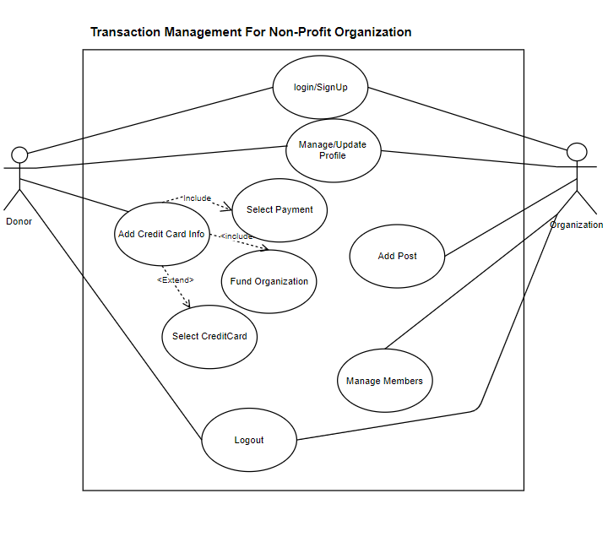
Use Case Diagram

Slide 12
Project Log
We all met on 09/14/2019 and checked the progress of each member.

Slide 13
Hardware and Software Requirements
Hardware:
Laptops and PCs
Software:
Java, HTML, and jQuery
Environment: Eclipse IDE and JavaEE

Slide 14
Project Plan
In each iteration we will try to display our functionalities that we have completed by that time and discuss what each person will be doing during the course of this project and who will be the incharge of what.
Also adding more functionalities along time to make this application easier to use for users.

